Slide 1


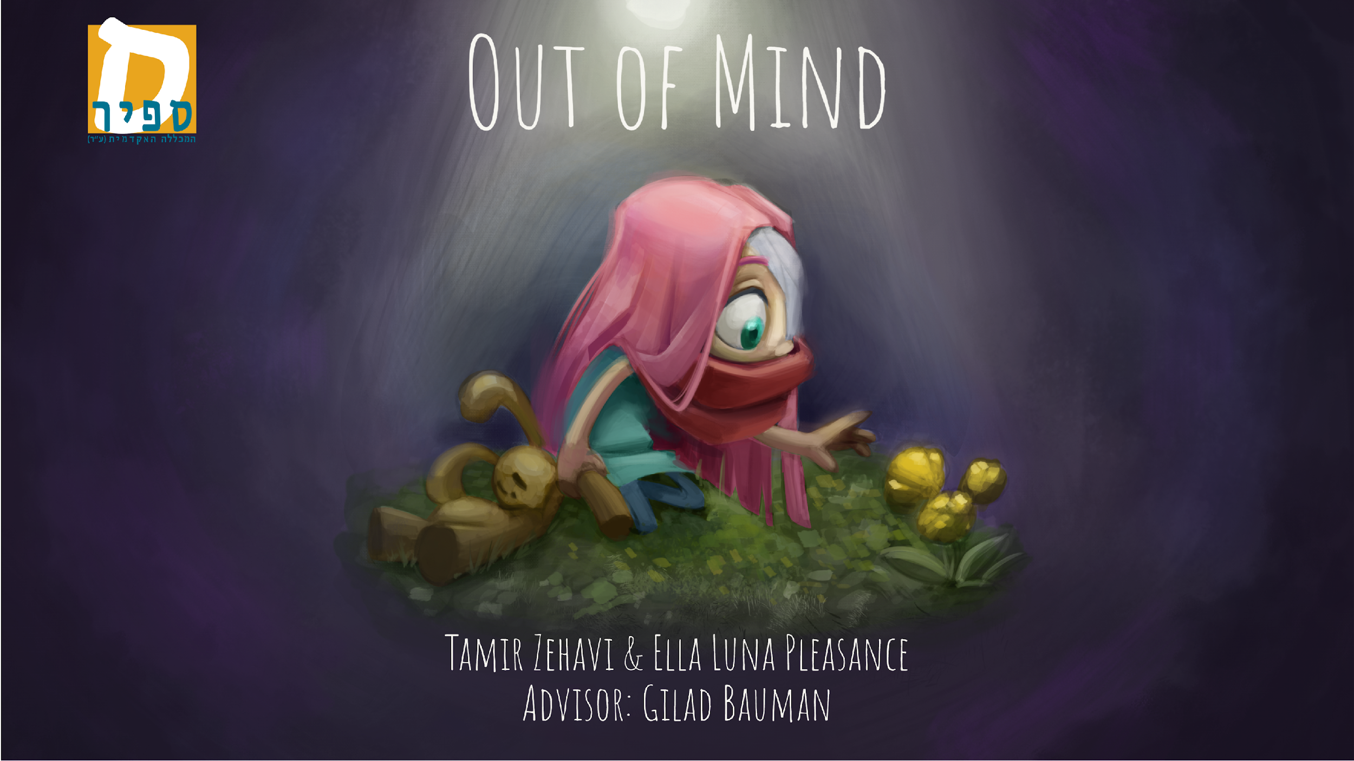

Slide 2
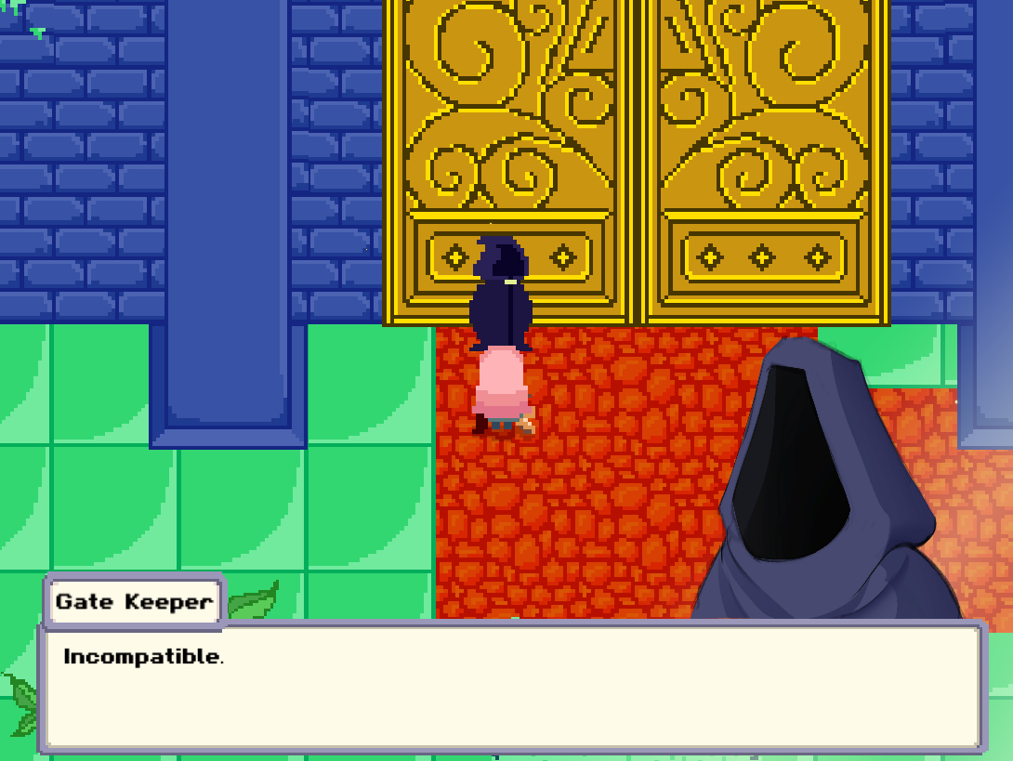
About the game
An RPG, story-driven, choice-based game
The game wants to provide a retro experience
Based on 90’s console game

Slide 3
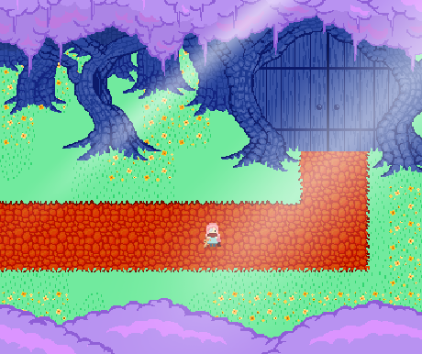
The story
A silent girl, wakes up in a strange, unfamiliar world
She begins a journey to find her way home
Along the way, she meets new friends who help her uncover her mysterious past
The game focuses on story, choices, and puzzles - with no combat or crafting

Slide 4
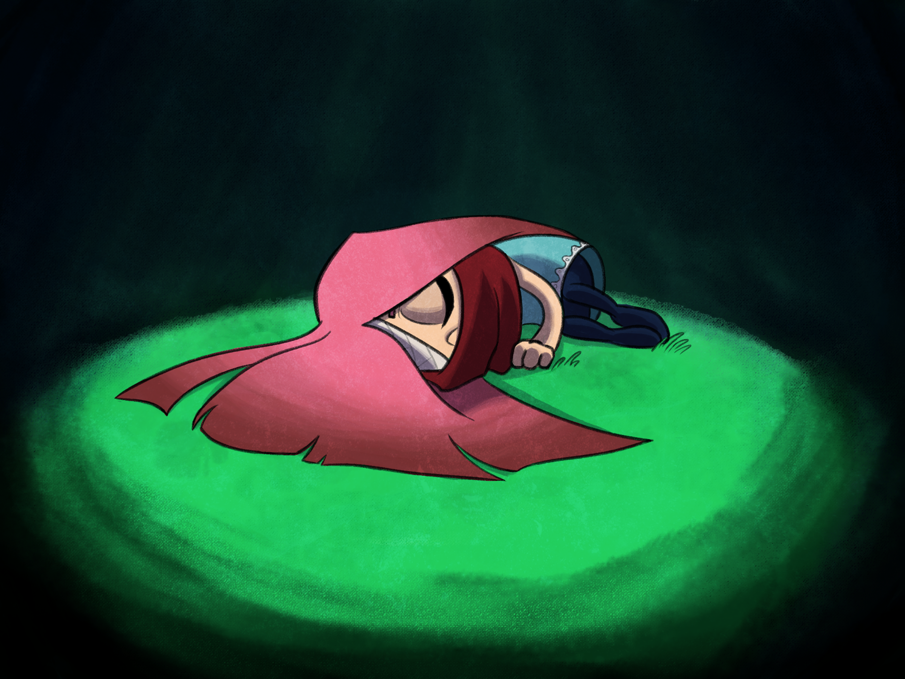
Social goal
The goal of the game is to raise awareness for people who deal with mental health issues
Various elements of the quests represent different challenges from the world of people who deal with mental issues

Slide 5
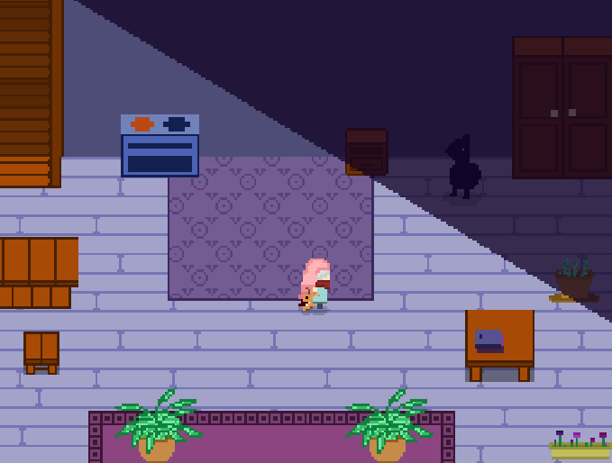
Project goals
Our goal is to make a game that directly involve the player
We want to make him feel that his choices change the game’s world
How did we achieve this?
We developed a complex dialogue system that changes with every choice the player makes

Slide 6
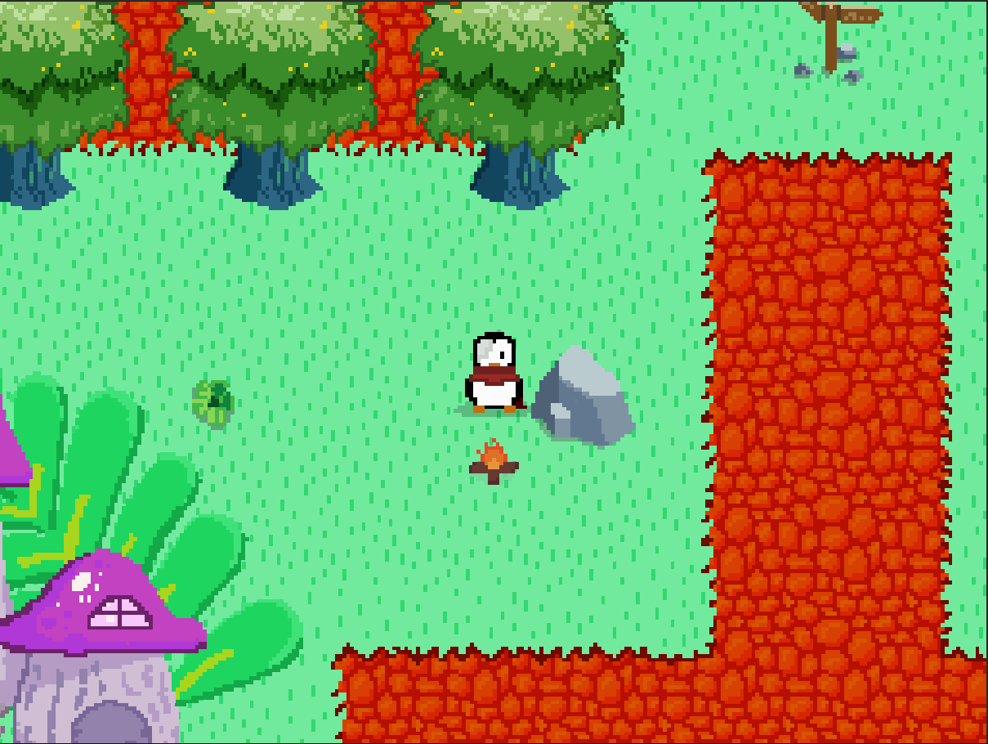
The problem
Each character responds differently based on the game's current state
Characters are made aware of the game’s situation at any given moment
A quest system was designed to support player choice
The system handles both parallel and mutually exclusive tasks

Slide 7
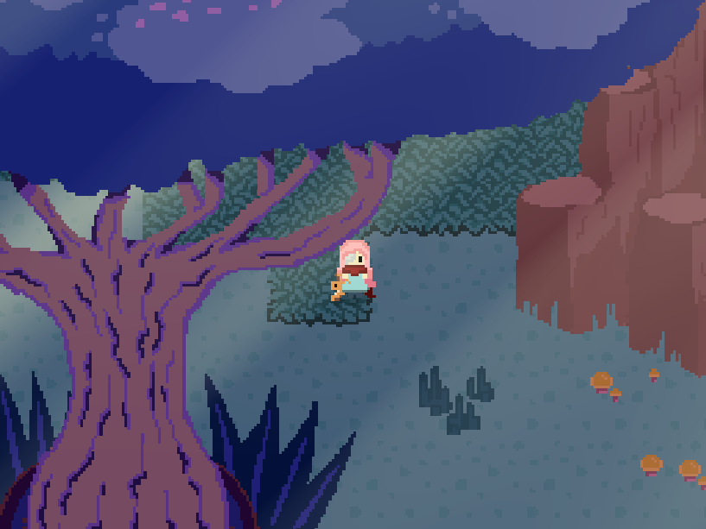
Achieving these goals
The dialogue system:
Listens to events triggered by the quest tree
Allowing it to know which dialogues to load
Singleton design pattern for the game management components

Slide 8
Quest manager
The quest system follows two design patterns:
Observer
State machine
Dialogue Manager
State entered
Quest Manager
State exited
NPC Base

Slide 9
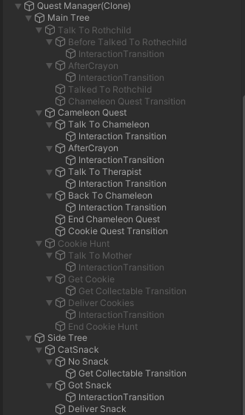
Structure & flow
The quest tree is built recursively from smaller trees
Each representing a task as a state machine
Each quest has states and transitions between them, triggered by different actions

Slide 10
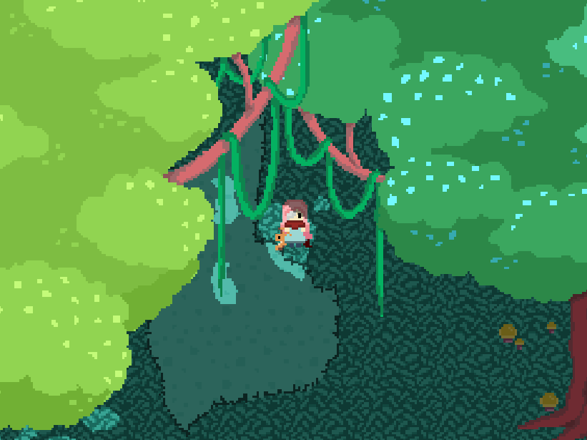
Structure & flow
All quest trees are managed by a Quest Manager
The QM keeps track of all active quests at any given moment
The Dialogue Manager holds all dialogues currently in use
Loading them from a JSON file using the Newtonsoft library

Slide 11
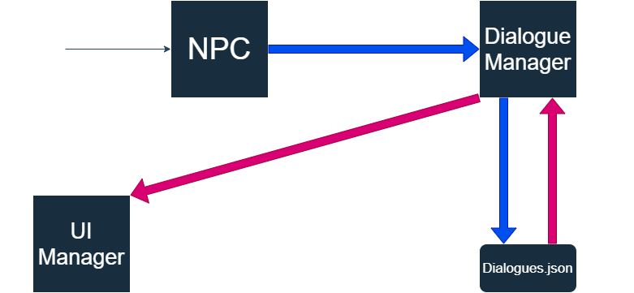
Dialogue system flow chart

Slide 12
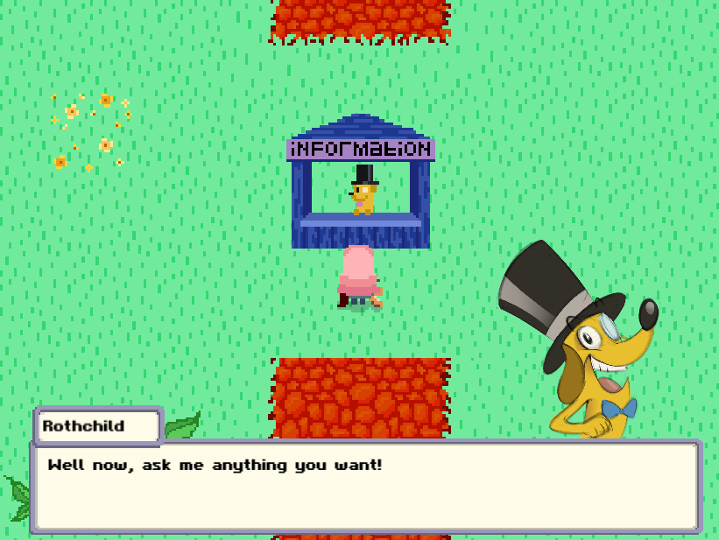
Questions?

